Slide 1
Business Intelligence with excel
Power Query
Lookup
Pivot

Slide 2
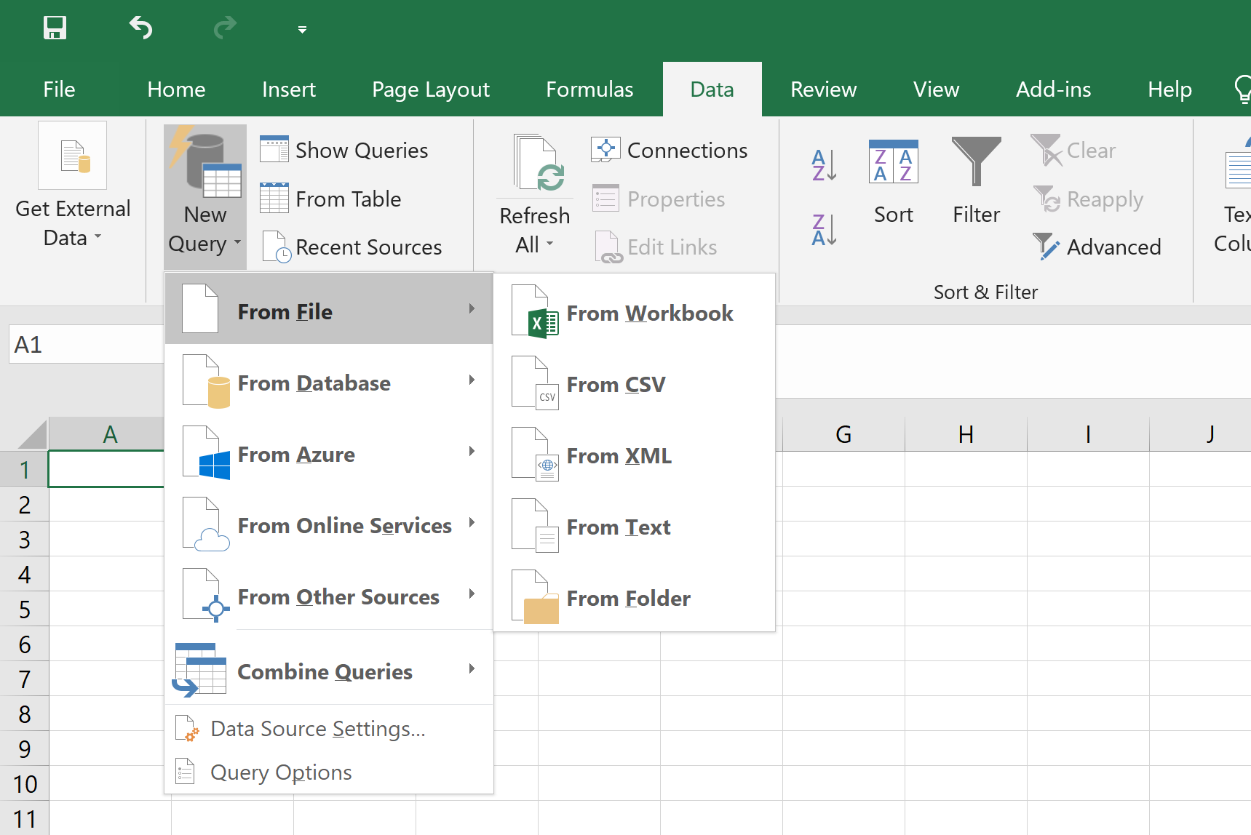
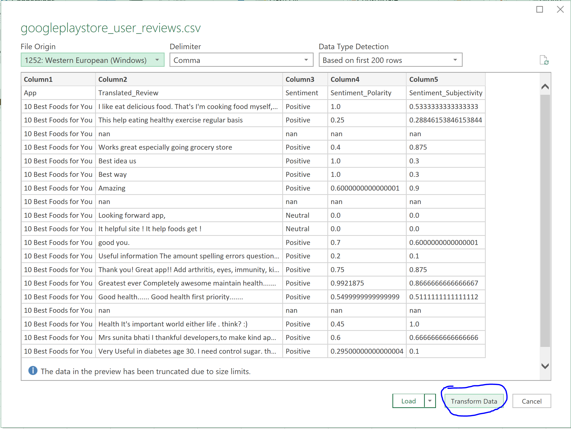
POWER QUERY – LOAD DATA
Load in from (1) Excel file, (2) text/ CSV file, (3) table/ range of data …

Slide 3
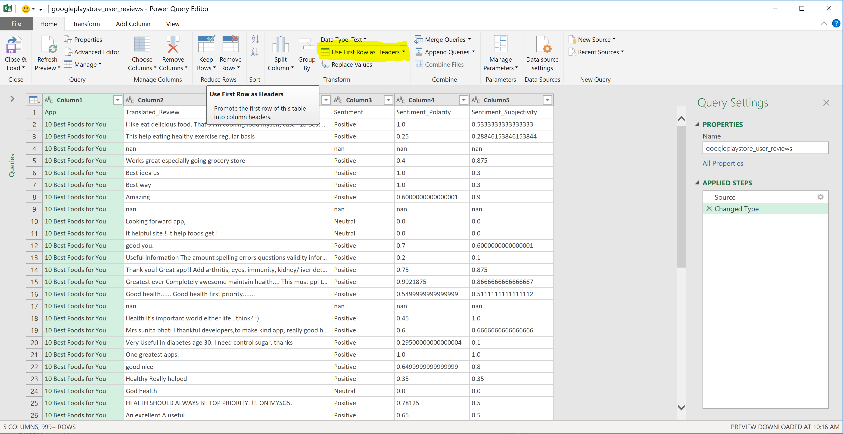
POWER QUERY – EDIT DATA
Workspace for multiple datasets. You can format columns, remove columns, reorder columns, filter rows, perform calculations, merge datasets (and realize the matching record number instantaneously).

Slide 4
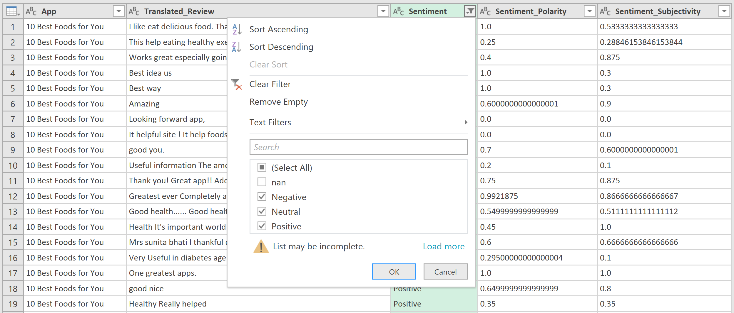
POWER QUERY – EDIT DATA
Workspace for multiple datasets. You can format columns, remove columns, reorder columns, filter rows, perform calculations, merge datasets (and realize the matching record number instantaneously).

Slide 5
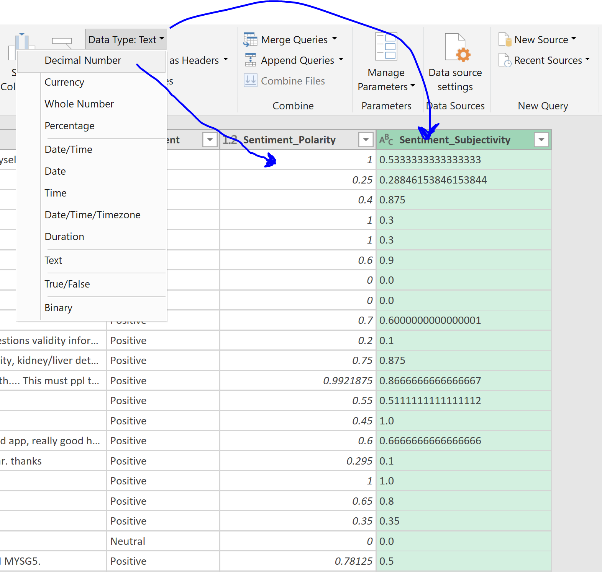
POWER QUERY – EDIT DATA

Slide 6
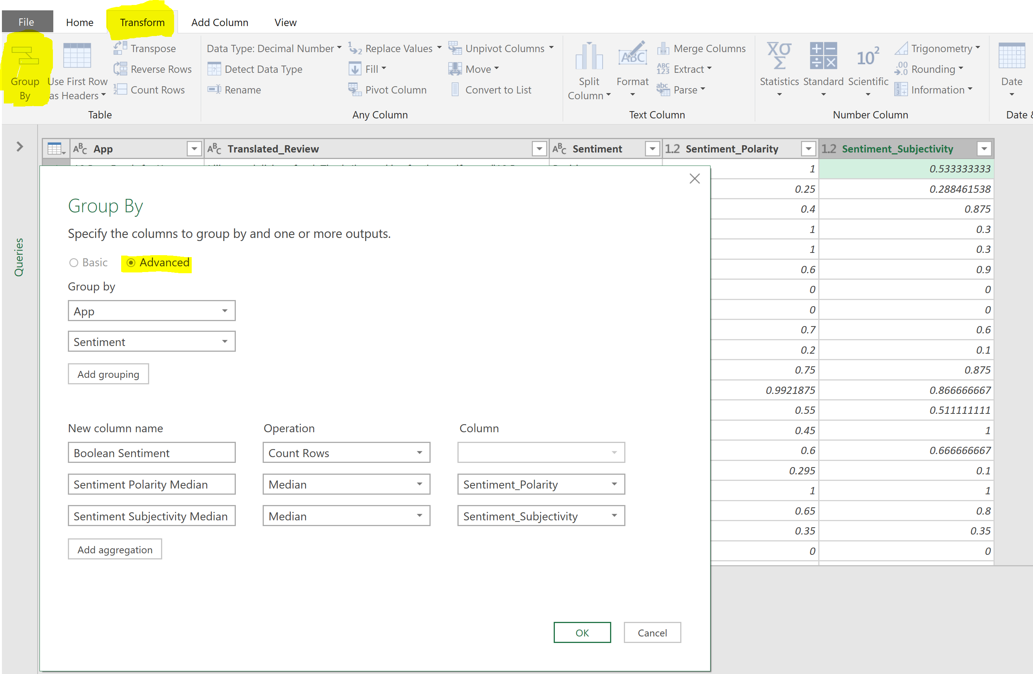
POWER QUERY – ANALYZE DATA

Slide 7
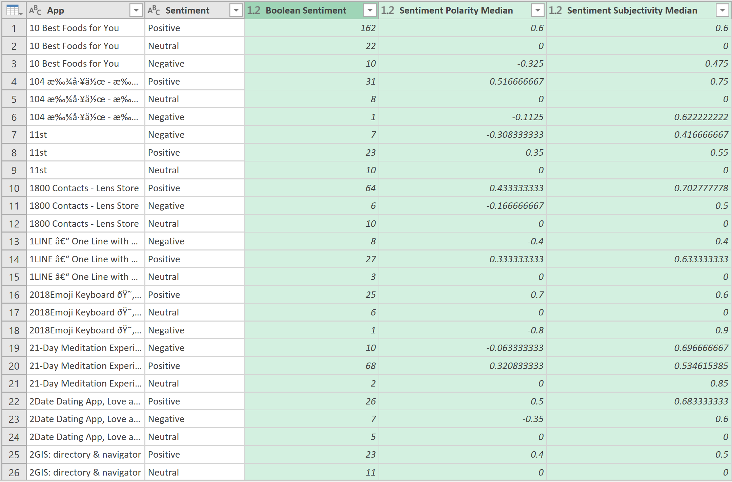
POWER QUERY – Pivoted DATA set

Slide 8
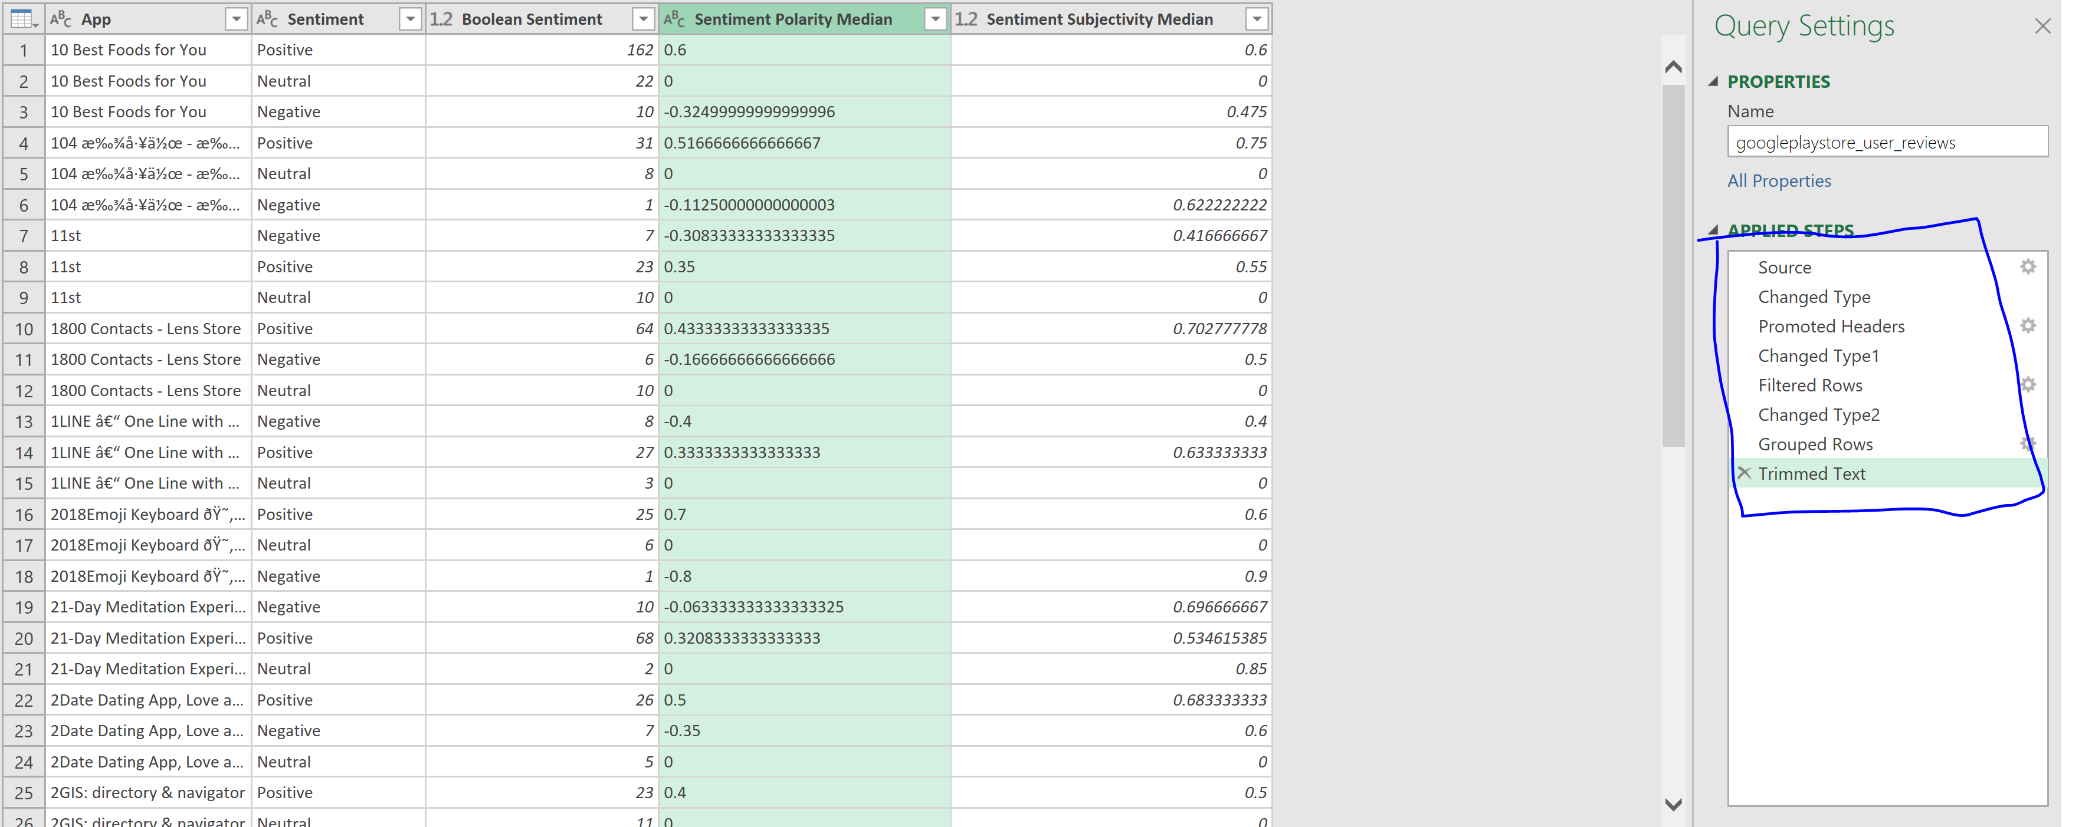
Power query – delete step from log

Slide 9
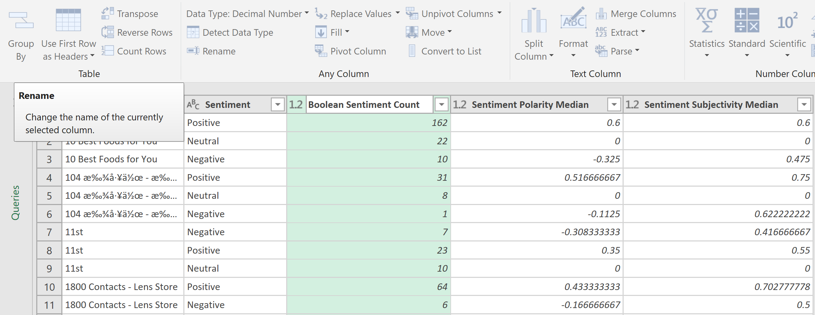
Power query – RENAME COLUMN

Slide 10
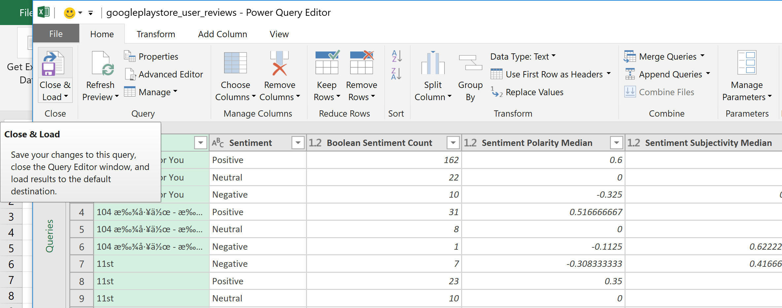
Power query – LOAD WRANGLED DATA

Slide 11
HELPFUL HOT KEYS
Select one cell/ column/ row, then Ctrl + Shift + ( ← / → / ↓ / ↑ ) to expand whole selection until hitting blank
Select one cell/ column/ row, then Shift + ( ← / → / ↓ / ↑ ) to expand selection one unit by one unit
Select multiple regions via holding Ctrl

